Slide 1
Customer Retention
Customer satisfaction has emerged as one of the most important factors that guarantee the success of online store; it has been posited as a key stimulant of purchase, repurchase intentions and customer loyalty. A comprehensive review of the literature, theories and models have been carried out to propose the models for customer activation and customer retention. Five major factors that contributed to the success of an e-commerce store have been identified as: service quality, system quality, information quality, trust and net benefit. The research furthermore investigated the factors that influence the online customers repeat purchase intention. The combination of both utilitarian value and hedonistic values are needed to affect the repeat purchase intention (loyalty) positively.
The data is collected from the Indian online shoppers. On the bases of the collected data
We tried to find the conclusion.

Slide 2
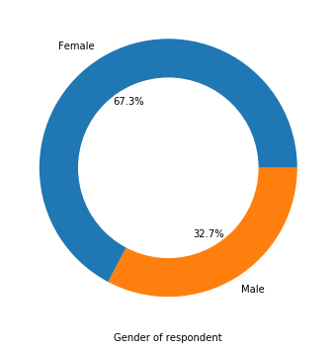
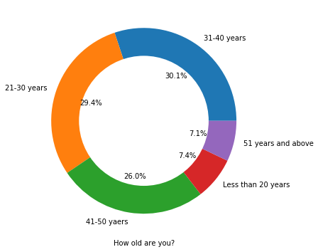

Slide 3
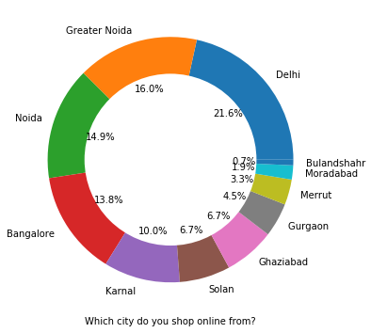
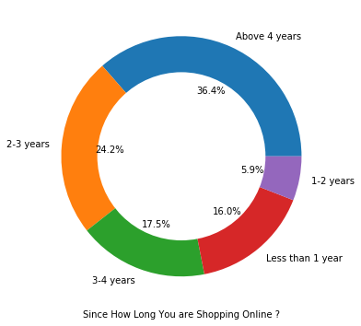

Slide 4
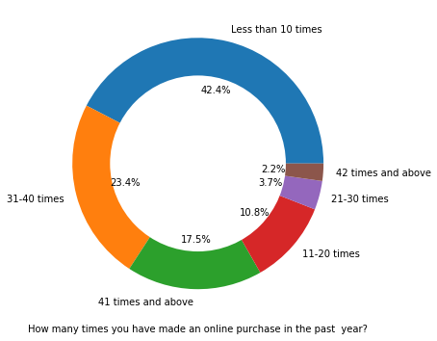

Slide 5
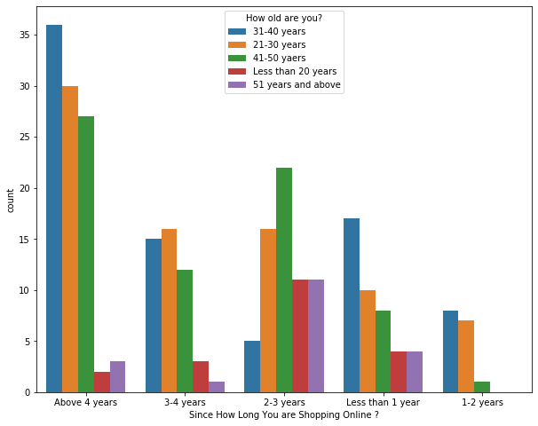

Slide 6
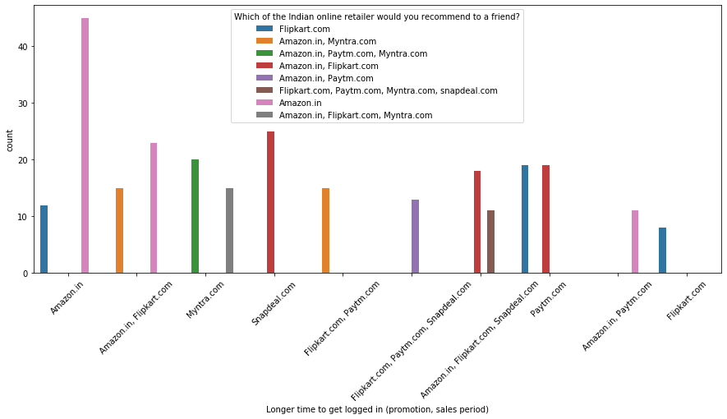
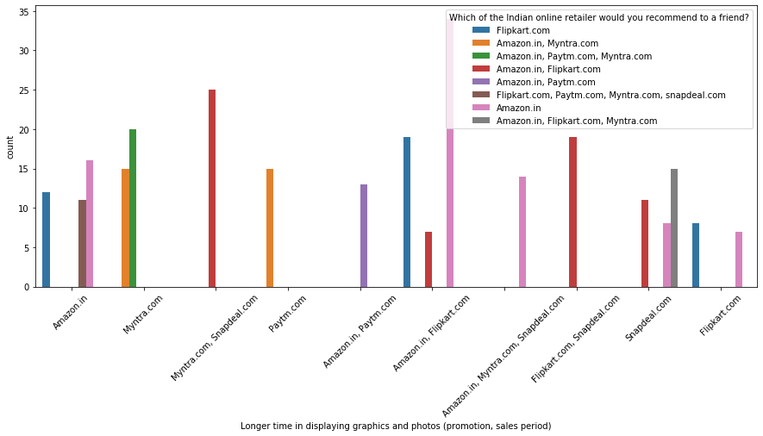

Slide 7
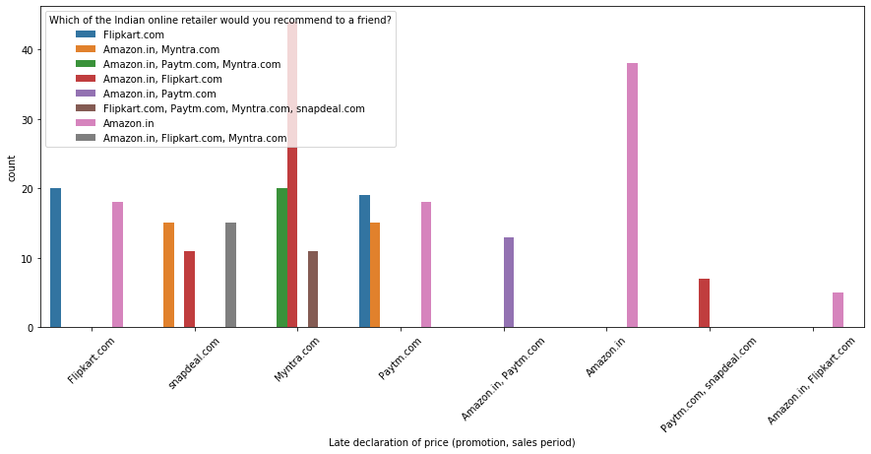
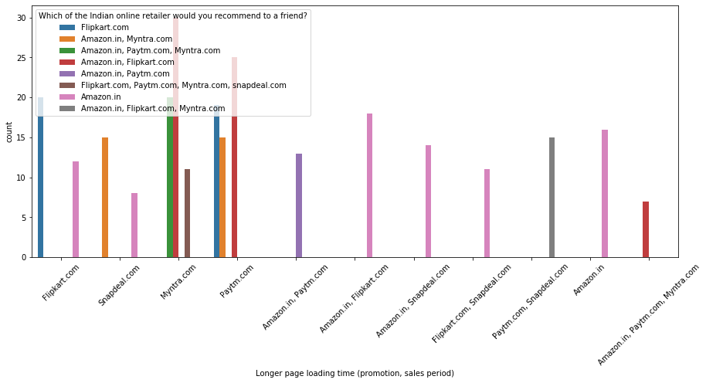

Slide 8
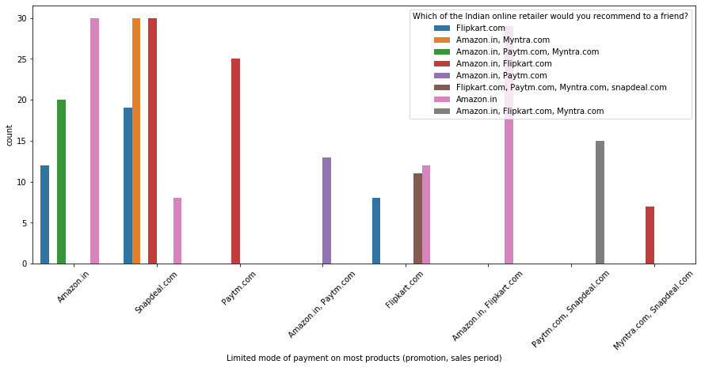
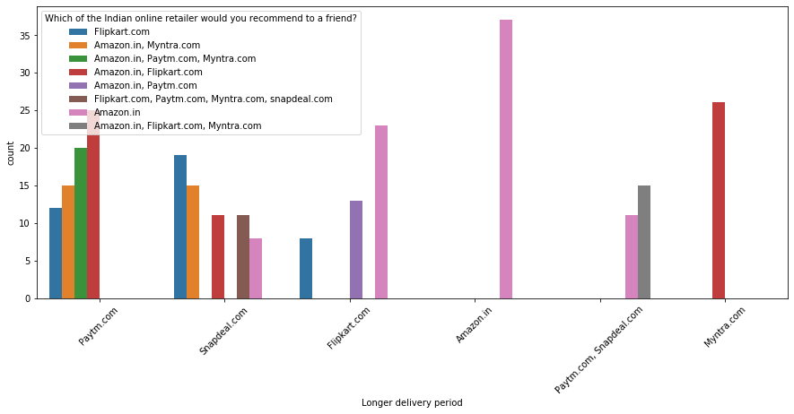

Slide 9
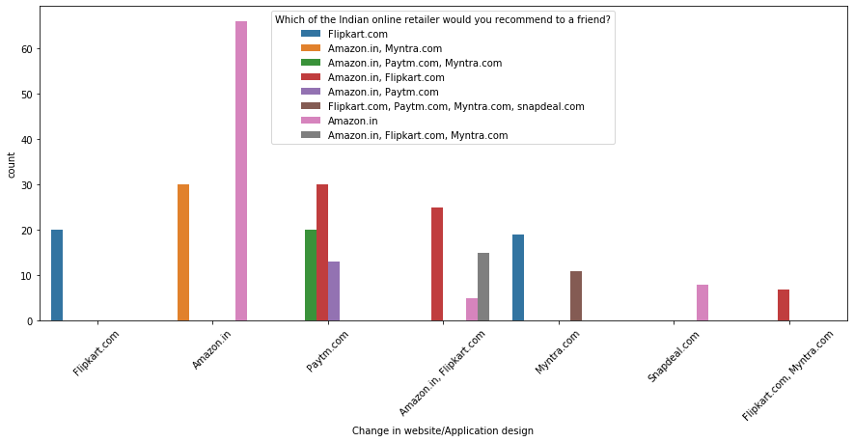
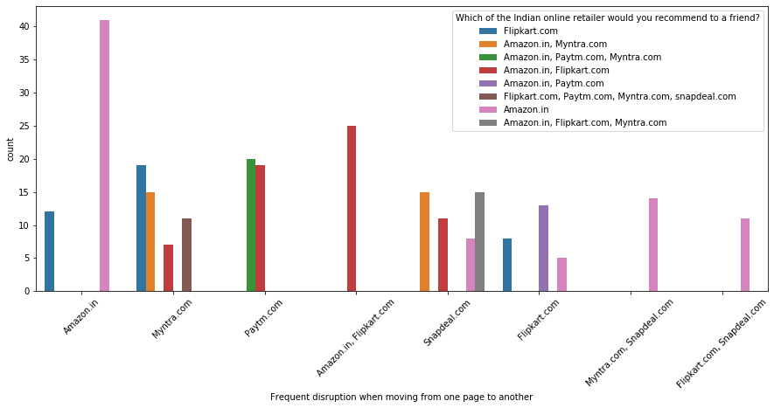

Slide 10

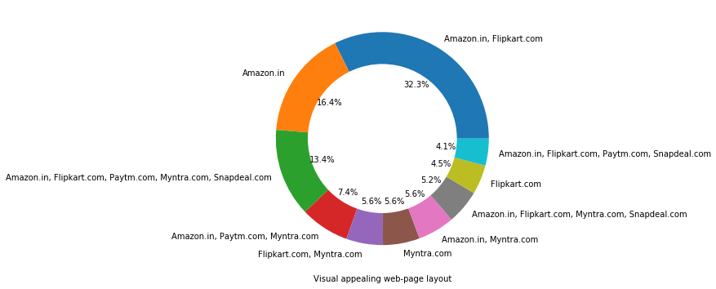

Slide 11
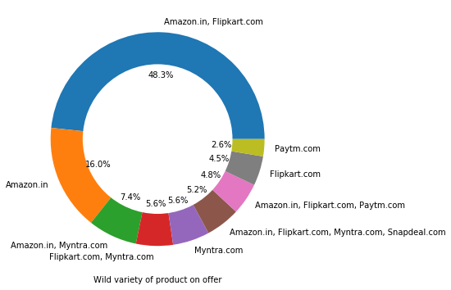
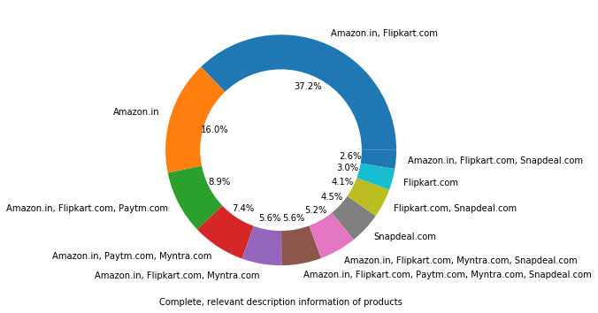

Slide 12
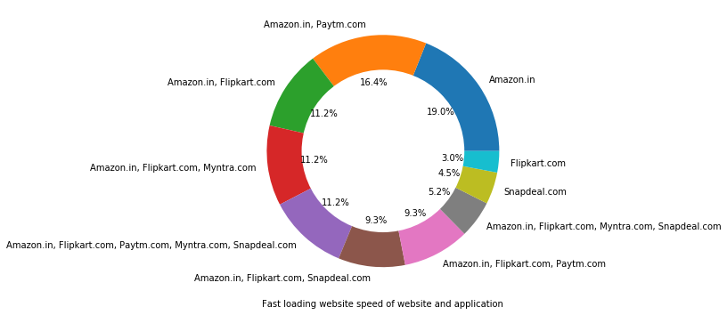
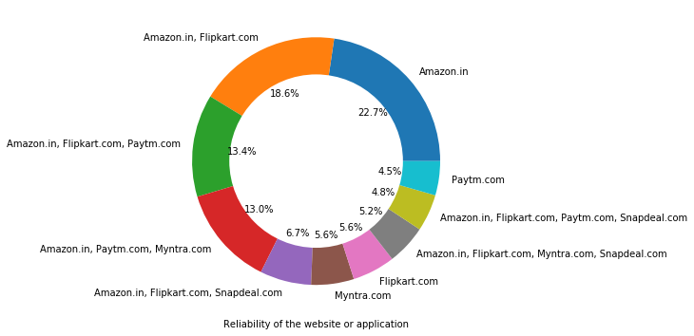

Slide 13
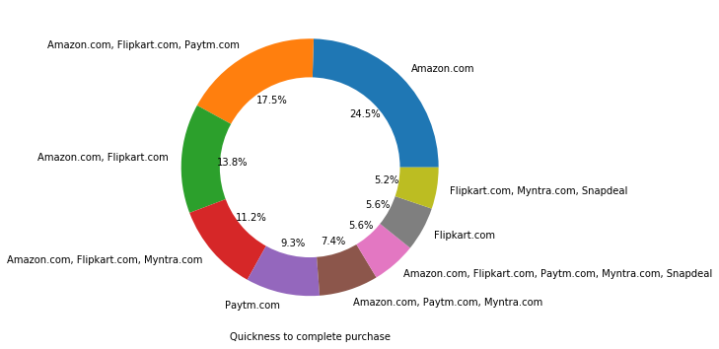
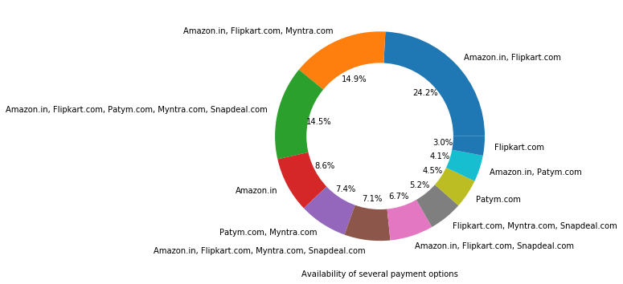

Slide 14
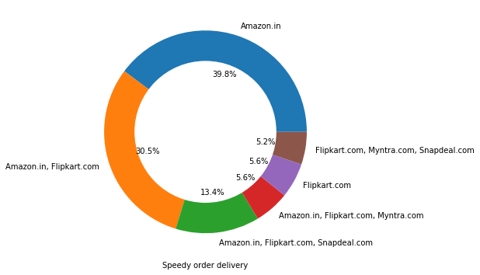
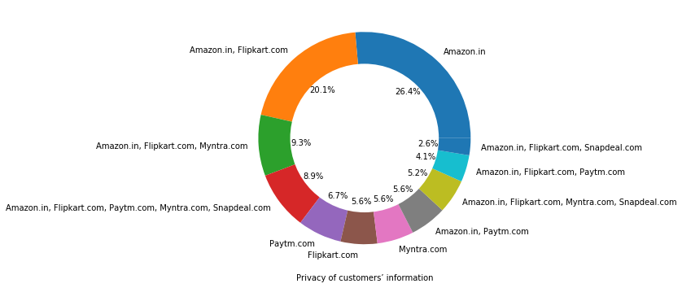

Slide 15
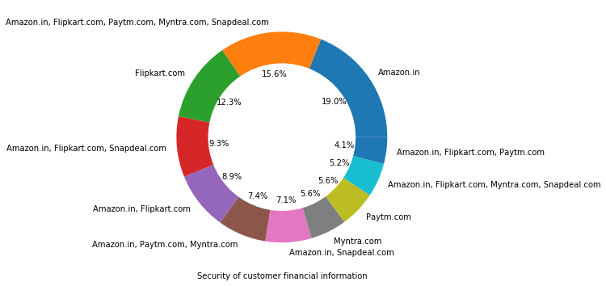
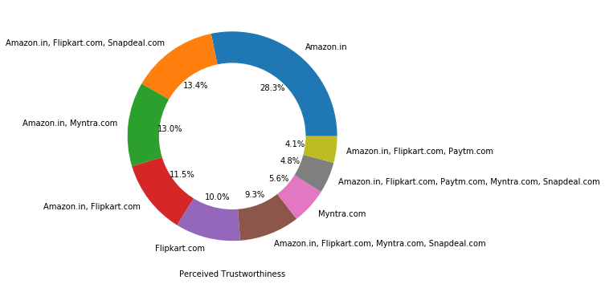

Slide 16
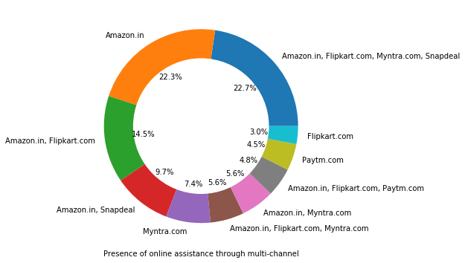

Slide 17
Conclusion:
The cost of the product, the reliability of the E-commerce company and the return policies all play an equally important role in deciding the buying behavior of online customers. The cost is an important factor as it was the basic criteria used by online retailers to attract customers. The reliability of the E-commerce company is also important, as it is even required in offline retail. It is important because customers are paying online, so they need to be sure of security of the online transaction. The return policies are important because in online retail customer does not get to feel the product
we can see that Amazon is winning in every perspective.

